Slide 1
Function outputs
Return statement

Slide 2
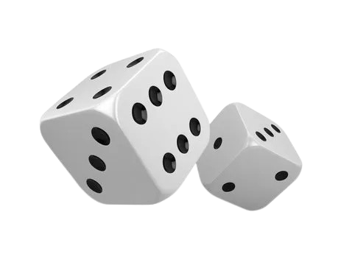
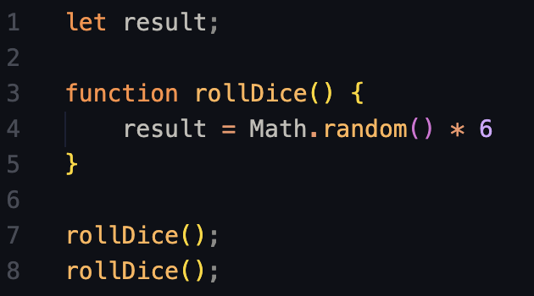
Re-use functions
We need to be able to reuse the function and store the result in different places
In this example every time we call rollDice(), the result will be stored in the variable result.
What happens if we call the function many times?
Try writing this and logging the result.

Slide 3
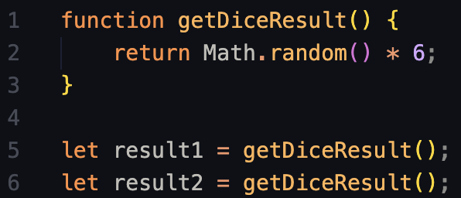
Re-use functions
That’s when the ‘return’ keyword comes into play
What happens if we log both result variables? Why?

Slide 4
How does this code work?
Let’s read it like the computer does.

Slide 5
Let’s look at the first block of code

Slide 6

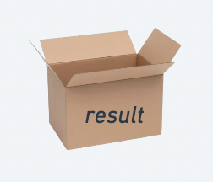
Variable declaration
We declare an empty variable named “result”

Slide 7
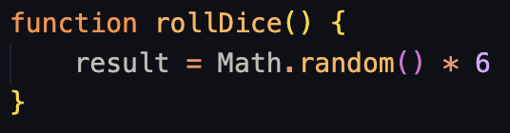
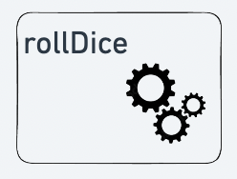
Function declaration
We declare a function that, when called, will generate a random number up to 6 and store it in the variable we just declared.

Slide 8

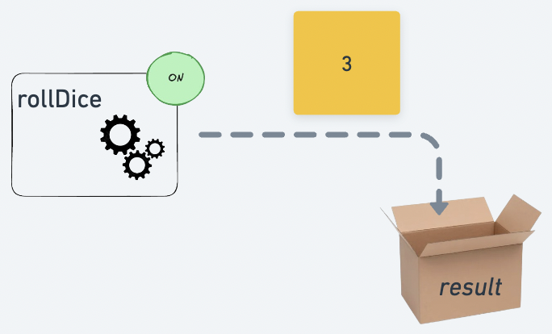
Function call #1
We call the function the first time. It generates a random number and saves it in “result”

Slide 9
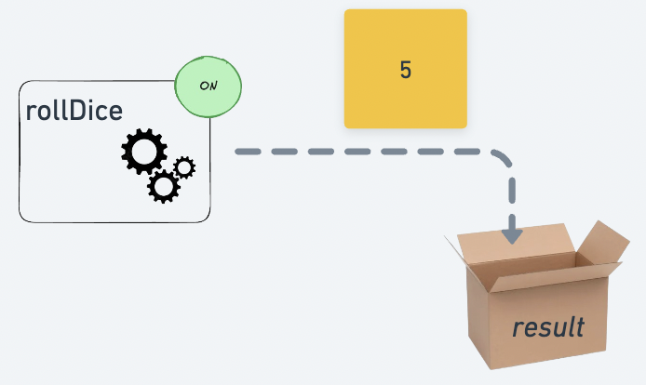
Function call #2
We call the function a second time. It generates a new random number and saves it in “result”

Slide 10


Result?
If we log “result” we can see that the value is the last number generated by our function.
It saved the last value, but we lost the first one.

Slide 11
Now let’s see the second one

Slide 12
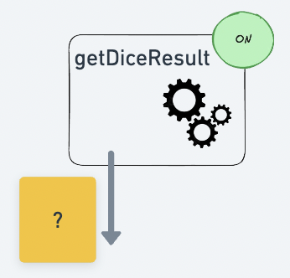
Function declaration
We declare a function that, when called, will generate a random number up to 6. We can decide what do with this value.

Slide 13
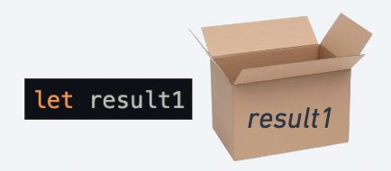
Variable declaration
We declare a new variable where we want to save our first random number.

Slide 14
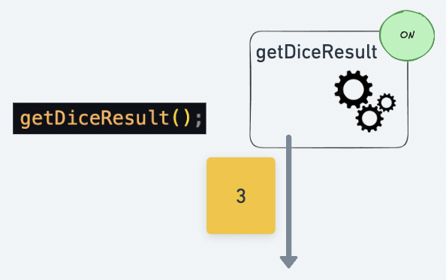
Variable declaration
The function is called and generates a random number.

Slide 15
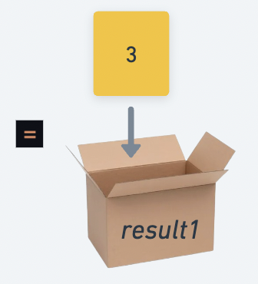
Variable declaration
The “return” of the function gets saved in our variable.

Slide 16
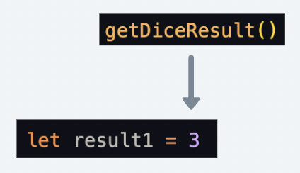
Variable declaration
We can think of it this way.

Slide 17
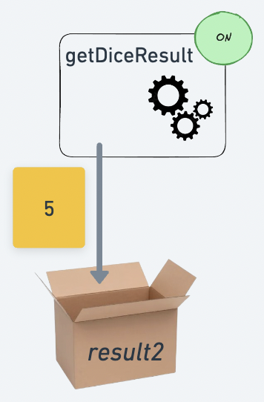
Variable declaration
The same happens for the second variable, only this time a new number is generated.

Slide 18


Result
Now we have saved the two different values in separate variables

Slide 19


We don’t even need the variables!

Slide 20
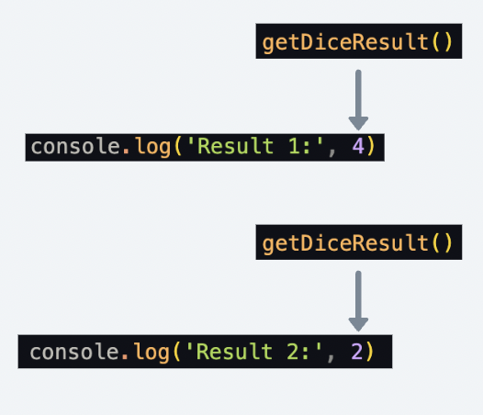
We don’t even need the variables!

